Slide 1

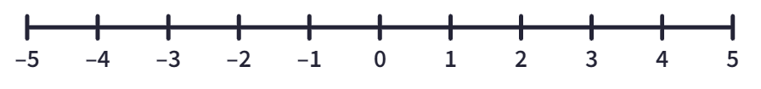
Subtopic N1.13 – Positioning negative numbers on a number line
LEARNING OUTCOME: To be able to place negative numbers on a number line
Objectives:
Keywords:
Integer
Number line
Whole number
Negative
To understand the position of negative numbers on a number line.
Using the distance from zero to understand the value of negative numbers.
How to read negative numbers using 0 as a symmetry point.
Introduction – Read and annotate:
Positioning negative numbers on a number line helps us understand how values extend below zero
and how they relate to positive numbers. There are two key things to remember here: Symmetry
around zero, where numbers the same distance from zero have the same size but opposite signs,
and that the further away a negative number is from zero, the smaller its value.
Definition
Characteristics
A negative integer is a whole number that is smaller than 0.
Numbers smaller than 0 are negative numbers and are represented by adding a “-” before the number.
Negative numbers are commonly used to represent things like temperature. Any ‘sub – zero- temperature is a negative value.
Examples
Negative integers
Non - Examples
-99
-3
-100
-1549
-1.5
3
-76.33
Positioning negatives on a number line when the scale is given
Steps | The negative number closest to zero is the largest. The negative number furthest from zero is the smallest.
Example 1 – I do Mark -1 on the number line with an x. Mark -2 on the number line with an x. Which number is larger?
Example 2 – We do Mark -4 on the number line with an x. Mark -3 on the number line with an x. Which number is smaller?
Example 3 – You do Mark -5 on the number line with an x. Mark -2 on the number line with an x. Which number is larger?
X
X
-1
is larger because it’s closer to zero
X
X
-4
is smaller because
it is further away from zero
X
X
-2
is larger because
it is closer to zero

Slide 2
Independent Practice
Question 1. Position the negative integers on the number lines and answer the questions:
a) -1 and -3. Which is larger? | b) -1 and -5. Which is smaller?
c) -4 and -5. Which is larger? | d) -4 and -7. Which is larger?
e) -4 and -10. Which is larger? | f) -7 and -10. Which is smaller?
g) -7 and -8. Which is larger? | h) -7 and -9. Which is smaller?
i) -9 and -8. Which is smaller? | j) -1 and -9. Which is smaller?
X
X
X
X
-1
-5
X
X
X
X
-4
-4
X
X
X
X
-4
-10
X
X
X
X
-7
-7
X
X
X
X
-9
-9
Estimate, label and draw negatives on number lines
Steps | 1) Consider the midpoint on the scale and estimate where each value would lie in relation to this.
Example 1 – I do Mark -5, -2 and -9 on the number line.
Example 2 – We do Mark -8, -13 and -6 on the number line.
Example 3 – You do Mark -5, -17 and -10 on the number line.
-9
-5
-2
-13
-8
-6
-17
-10
-5

Slide 3
Independent Practice
Question 2. Position the negative integers on the number lines:
a) -5, -1 and -8
b) -10, -4 and -17
c) -8, -5 and -16
d) -15, -24 and -7
e) -10, -27 and -3
f) -40, -30 and -20
g) -15, -85 and -30
h) 0, -7 and -5
i) 0, -10 and 8
k) 0, -6 and 3
-8
-5
-1
-17
-10
-4
-16
-8
-5
-24
-15
-7
-27
-10
-3
-40
-30
-20
-85
-30
-15
-7
-5
0
-10
0
8
-6
0
3

Slide 4
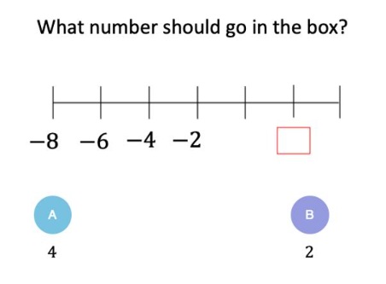
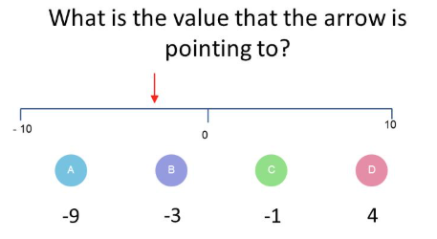
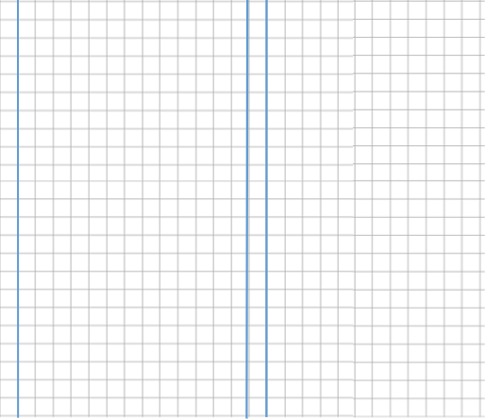
Skills Check

